Slide 1

Node.js
Module 8 – Authentication With Passport and JWT

Slide 2
Agenda
Stateful vs. Stateless Authentication
OAuth2
Passport
JWT – JSON Web Tokens

Slide 3
Stateful vs. Stateless Authentication
Historically authentication has always been a stateful service
Now, In modern days web architecture, with multiple clients (SPA, mobile …) it becomes an issue.
Restful services are stateless by definition, and authentication should be that way too.

Slide 4
Token based Authentication
Token based authentication ensures that each request to a server is accompanied by a signed token which the server can verify it’s authenticity.
Tokens are self-contained and contain all the information needed for authentication, this makes them stateless, scalable and decoupled

Slide 5

What is OAuth2?
Version 2 of the OAuth protocol
This protocol allows third-party applications to grant limited access to an HTTP service, either on behalf of a resource owner or by allowing the third-party application to obtain access on its own behalf.

Slide 6
Roles
Resource Owner: generally yourself.
Resource Server: server hosting protected data (for example Google hosting your profile and personal information).
Client: application requesting access to a resource server (it can be your PHP website, a Javascript application or a mobile application).
Authorization Server: server issuing access token to the client. This token will be used for the client to request the resource server. This server can be the same as the authorization server (same physical server and same application), and it is often the case.

Slide 7
Tokens
Tokens are random strings generated by the authorization server and are issued when the client requests them.
Access Token
Refresh Token
Scope is a parameter used to limit the rights of the access token.

Slide 8
Authorization grant types
OAuth2 defines 4 grant types depending on the location and the nature of the client involved in obtaining an access token.
Authorization Code Grant (server-side Applications)
Implicit Grant (redirect to login page)
Resource Owner Password Credentials Grant
Client Credentials Grant (client credentials )

Slide 9
Resource Owner Password Credentials Grant
Resource Owner: You have an account on AbcCompany.com website of the Abc company
Client: abc.com SPA/mobile app askes for your credentials inside a login page.
Resource Server: Abc company is exposing its API at api.abc.com
Authorization Server: an Abc company server hosted at auth.abc.com

Slide 10
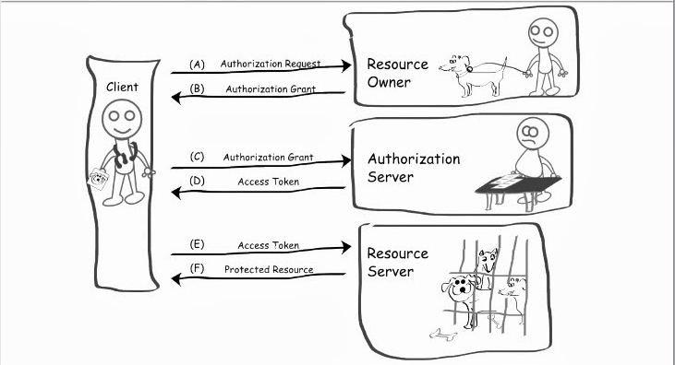
Resource Owner Password Credentials Grant
Login Page
Node.JS Oauth
Express API

Slide 11
Passport
Passport is an authentication middleware for Node.js
It can be dropped into any Express based web application.
Passport's sole purpose is to authenticate requests, which it does through an extensible set of plugins known as strategies.

Slide 12
Strategies
Passport uses the concept of strategies to authenticate requests.
Strategies can range from verifying username and password credentials, delegated authentication using OAuth (for example, via Facebook or Twitter), or federated authentication using OpenID.
passport.use(new LocalStrategy( function(username, password, done) { User.findOne({ username: username }, function (err, user) { if (err) { return done(err); } if (!user) { return done(null, false); } if (!user.verifyPassword(password)) { return done(null, false); } return done(null, user); }); } ));

Slide 13
Passport Middleware
To use Passport in an Express-based application, configure it with the required passport.initialize() middleware
const app = express();
app.use(require('serve-static')(__dirname + '/../public’));
app.use(require('cookie-parser')());
app.use(require('body-parser').urlencoded({extended:true }));
app.use(passport.initialize());

Slide 14
Passport Local Startegy
The most widely used way for websites to authenticate users is via a username and password.
Support for this mechanism is provided by the passport-local module.
passport.use(new LocalStrategy( function(username, password, done) { User.findOne({ username: username }, function (err, user) { if (err) { return done(err); } if (!user) { return done(null, false); } if (!user.verifyPassword(password)) { return done(null, false); } return done(null, user); }); } ));

Slide 15
JWT – JSON Web Tokens
JWT is a compact URL-safe means of representing claims to be transferred between two parties.
The claims are encoded as a JSON object that is digitally signed by hashing it using a shared secret between the parties.
JWT is an open, industry standard RFC 7519

Slide 16

JSON Web Token structure
JSON Web Tokens consist of three parts separated by dots (.), which are:
Header
Payload
Signature

Slide 17
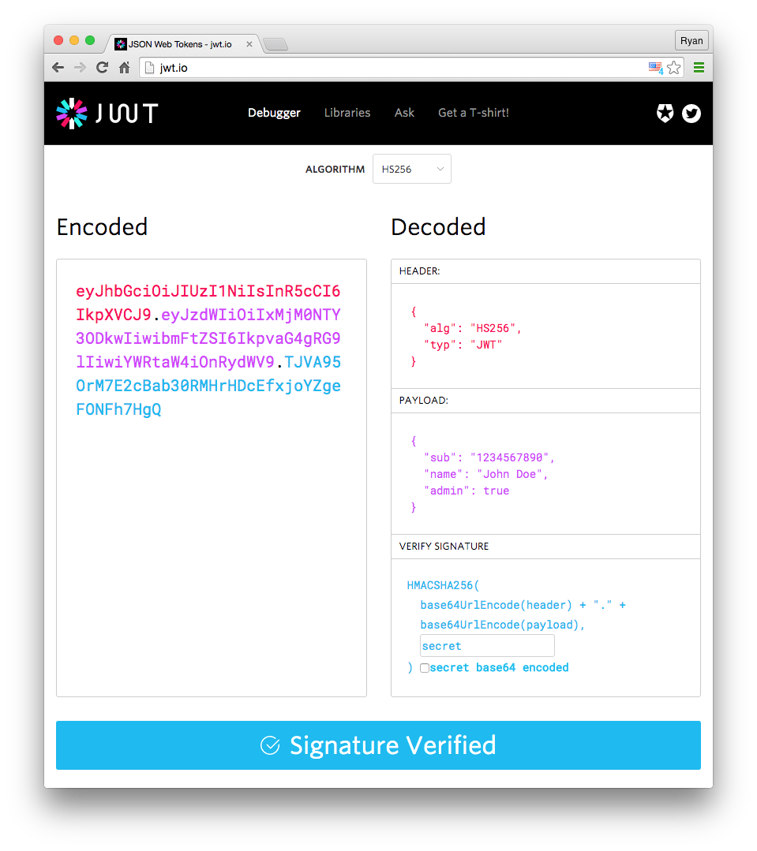
JSON Web Token Decoded (https://jwt.io/)

Slide 18
Passport and JWT
Jsonwebtoken – node.js library for creating, verifying and decoding JWT.
> npm install jsonwebtoken

Slide 19
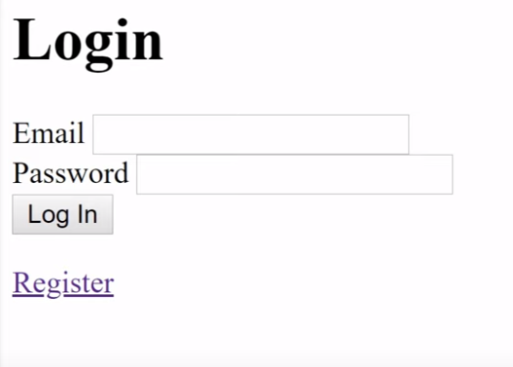
LOGIN SERVER
Part5 / server2
npm i express ejs nodemon dotenv

Slide 20
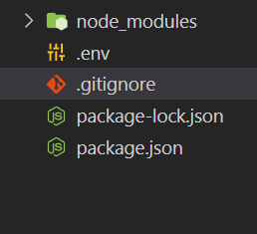
SERVER
.env
.gitignore

Slide 21
template engines
EJS files typically have an .ejs extension (like index.ejs). They can contain both standard HTML and embedded JavaScript code. The JavaScript code is placed between <% %> delimiters.

Slide 22
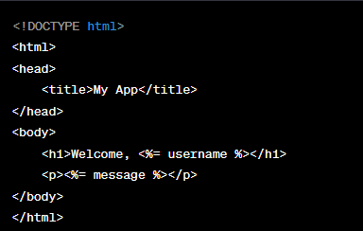
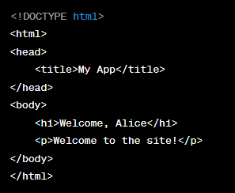
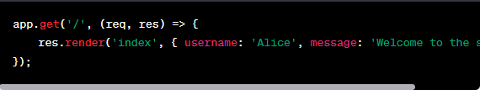
template engines

Slide 23
SERVER
.env
.gitignore
npm i bcrypt //to secure the app
npm install uuid //universal uniqe id
npm i passport passport-local express-session express-flash

Slide 24
SERVER
passport:
Explanation: Passport is authentication middleware for Node.js. It's incredibly flexible and supports various authentication methods, known as "strategies" (e.g., local, OAuth, JWT).
Usage: You'd typically use Passport when you need to authenticate users.
express-session:
Explanation: This middleware handles session management in Express applications. Sessions allow you to store data between HTTP requests, which is essential for maintaining state in stateless protocols like HTTP.
Usage: You'd use this for tracking logged-in users and storing user-specific data between requests.

Slide 25
SERVER
express-flash:
Explanation: Express-flash is middleware that facilitates displaying flash messages to users. Flash messages are typically used to display one-time messages to the user, like success or error notifications.
Usage: You'd use this to show messages after certain operations, e.g., after a failed login attempt or after successfully saving data.

Slide 26
strategy
In the context of authentication systems, especially with Passport.js in Node.js, a "strategy" refers to a method or mechanism by which authentication can be achieved.
Passport.js, as a middleware, abstracts away much of the boilerplate of handling different authentication methods, but it does so in a way that's extensible. This extensibility comes from "strategies."
Here's a deeper look at what a strategy is:
Abstracted Authentication Mechanism: Each strategy is an abstracted authentication mechanism. Whether it's verifying a username and password against a database, checking an OAuth token against Google's authentication servers, or verifying a JSON Web Token, each of these mechanisms can be wrapped up in a strategy.
Plug-and-Play: Because of this design, developers can mix and match strategies as needed. Need local authentication and Google OAuth in the same app? No problem. Just configure both strategies, and you're good to go.

Slide 27
strategy
Examples:
LocalStrategy: Used for local username (or email) and password authentication.
OAuth2Strategy: Used for OAuth 2.0 authentication (like logging in with Google, Facebook, etc.)
BearerStrategy: Used for token-based authentication, like JWT.
Custom Strategies: If none of the many community-contributed strategies do what you need, you can create your own strategy. This provides the flexibility to integrate with virtually any authentication system or backend.
In essence, a strategy in Passport.js (and in other systems that adopt a similar architecture) encapsulates a specific authentication mechanism in a way that's easy to integrate, consistent, and modular. This design choice is what has made Passport.js one of the go-to authentication libraries for Node.js developers.

Slide 28
JWT TOCKEN
server3
npm install express ejs bcryptjs jsonwebtoken
http://calebb.net/

Slide 29
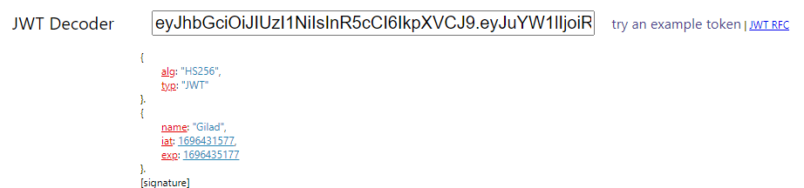
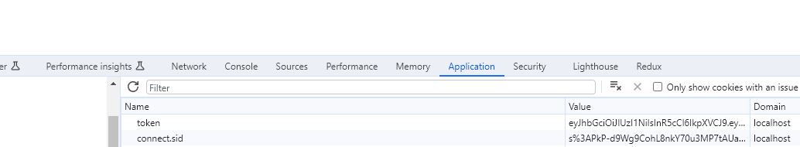
JWT TOKEN

Slide 30
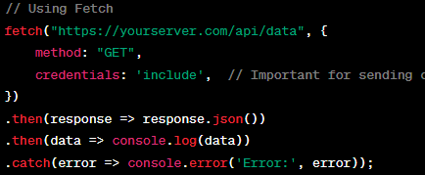
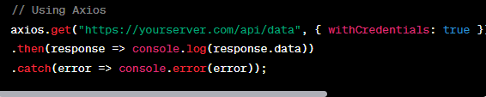
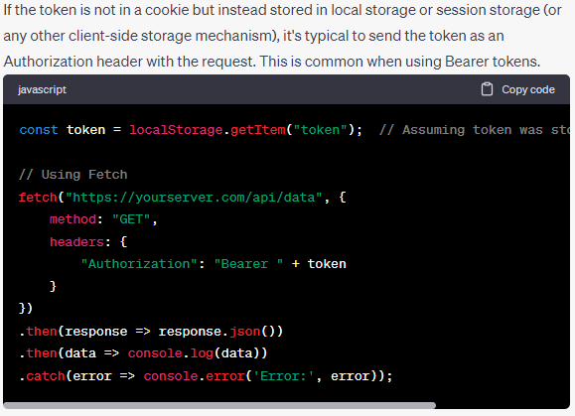

Slide 31
Server side :
npm install cookie-parser

Slide 32
OAuth2
Server4
npm install express passport passport-oauth2 cookie-session dotenv
npm install passport-google-oauth20

Slide 33
Setting up Google Developers Console
Setting up Google Developers Console:
Go to Google Developers Console.
Create a new project.
Navigate to OAuth 2.0 Client IDs under Credentials.
Create a new OAuth 2.0 Client ID of the type Web application.
Set the authorized redirect URIs to http://localhost:3000/auth/google/callback (for local development).
Note down the Client ID and Client Secret.
http://localhost:3000/auth/google

